Slide 1
Anova and Chi square Test

Slide 2
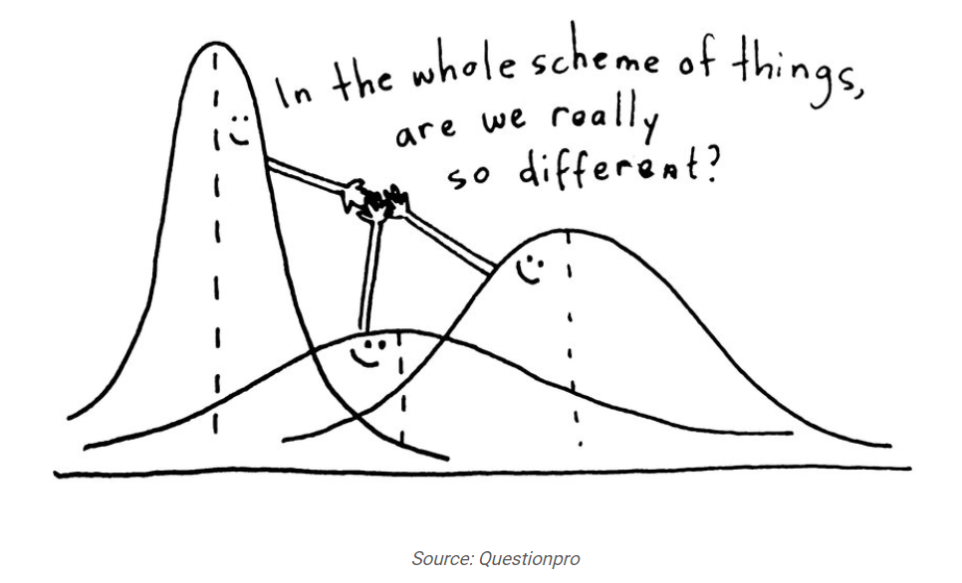
Anova
Analysis of Variance( ANOVA ) is a statistical technique which is used to check if the means of two or more groups are statistically different from each other.
It checks the impact of one or more factors by comparing the means of different samples.

Slide 3
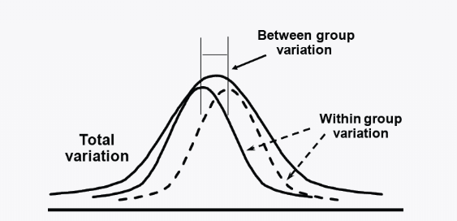
Terminologies used
Grand Mean: it is the average of sample means
Hypothesis: Ho: Ho: μ1 = μ2 = μ3
Ha: At least one mean is different
Variation between groups: For each data point look at the difference between its group mean and the overall mean
Variation Within Groups: Difference between data point and its sample mean

Slide 4
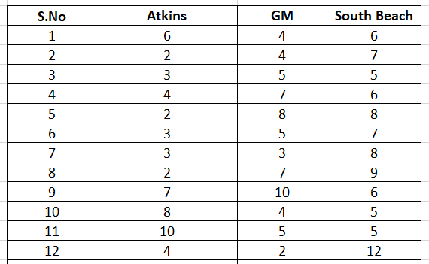
Example
A research institute wants to determine the best diet plan for weight loss and for this they have randomly selected 36 volunteers to analyze three diet plans ( Atkins , GM , South beach ) .Help the research institute in identifying the best diet plan by analyzing the weight lost by the volunteers.

Slide 5
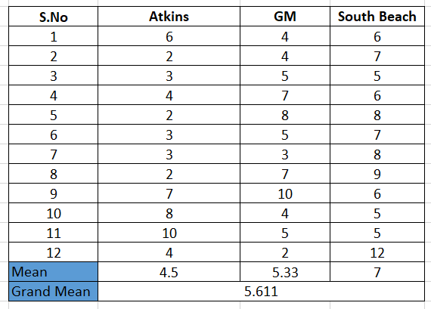
Calculations

Slide 6
Calculations
Deviation of mean with global Mean: (μ1 – μ)²
SS between group : product of Deviation of global mean with local mean and no. of data points
SS within group(Residual): total squared deviation of data points with its local mean
Sum of Squares Total: SS within group + SS between Group
F-ratio = ( SS Btwn Groups / DF )
(SS With Groups / DF)

Slide 7
Formulae

Slide 8
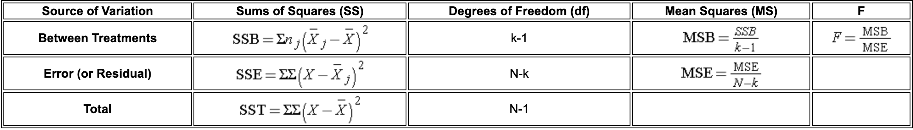

Slide 9
Conclusion
If calculated F ratio is greater than F value based on the degrees of freedom ,we reject Ho .

Slide 10
Chi-Square test
Chi-square tests of independence test whether two qualitative variables are independent, that is, whether there exists a relationship between two categorical variables
Hypotheses
The Chi-square test of independence is a hypothesis test so it has a null (H0) and an alternative hypothesis (H1):
H0 : the variables are independent, there is no relationship between the two categorical variables. Knowing the value of one variable does not help to predict the value of the other variable
H1 : the variables are dependent, there is a relationship between the two categorical variables. Knowing the value of one variable helps to predict the value of the other variable

Slide 11
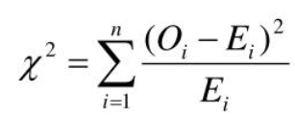
Chi-Square test
The chi-square test is used when the data is categorical and it detects the difference between observed data and what could we expect if the Ho is true.
O: Observed Frequency in the data for each type
E: Expected Frequency to see of each type if the null hypothesis was true.

Slide 12
How the test works
If the difference between the observed frequencies and the expected frequencies is small, we cannot reject the null hypothesis of independence and thus we cannot reject the fact that the two variables are not related
if the difference between the observed frequencies and the expected frequencies is large, we can reject the null hypothesis of independence and thus we can conclude that the two variables are related How the test works

Slide 13
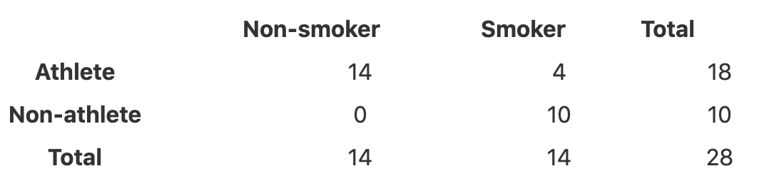
we want to determine whether there is a statistically significant association between smoking and being a professional athlete.
Smoking can only be “yes” or “no” and being a professional athlete can only be “yes” or “no”. The two variables of interest are qualitative variables, so we need to use a Chi-square test of independence, and the data have been collected on 28 persons

Slide 15
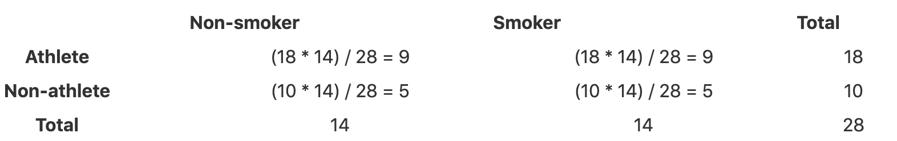
O: Observed Frequency in the data for each type
E: Expected Frequency to see of each type if the null hypothesis was true.

Slide 16
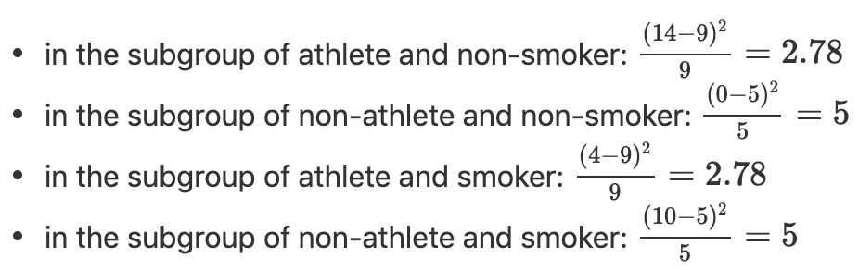
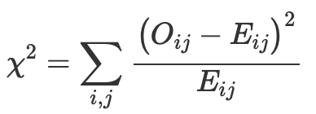
Test statistic
and then we sum them all to obtain the test statistic:
χ2=2.78+5+2.78+5=15.56

Slide 17
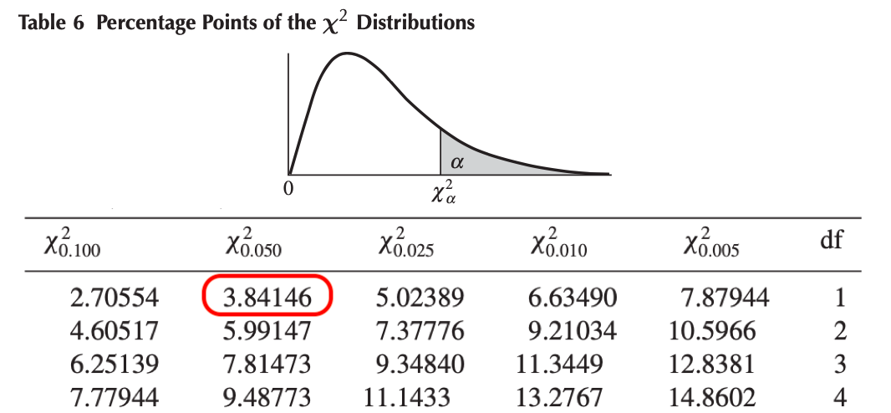
Critical value
df=(number of rows−1)⋅(number of columns−1)
Chi-square table (α=0.05 and df=1) : The critical value is 3.84146
test statistic=15.56>critical value=3.84146
Like for any statistical test, when the test statistic is larger than the
critical value, we can reject the null hypothesis at the
specified significance level

